Slide 1
Machine Learning – Products

Slide 2







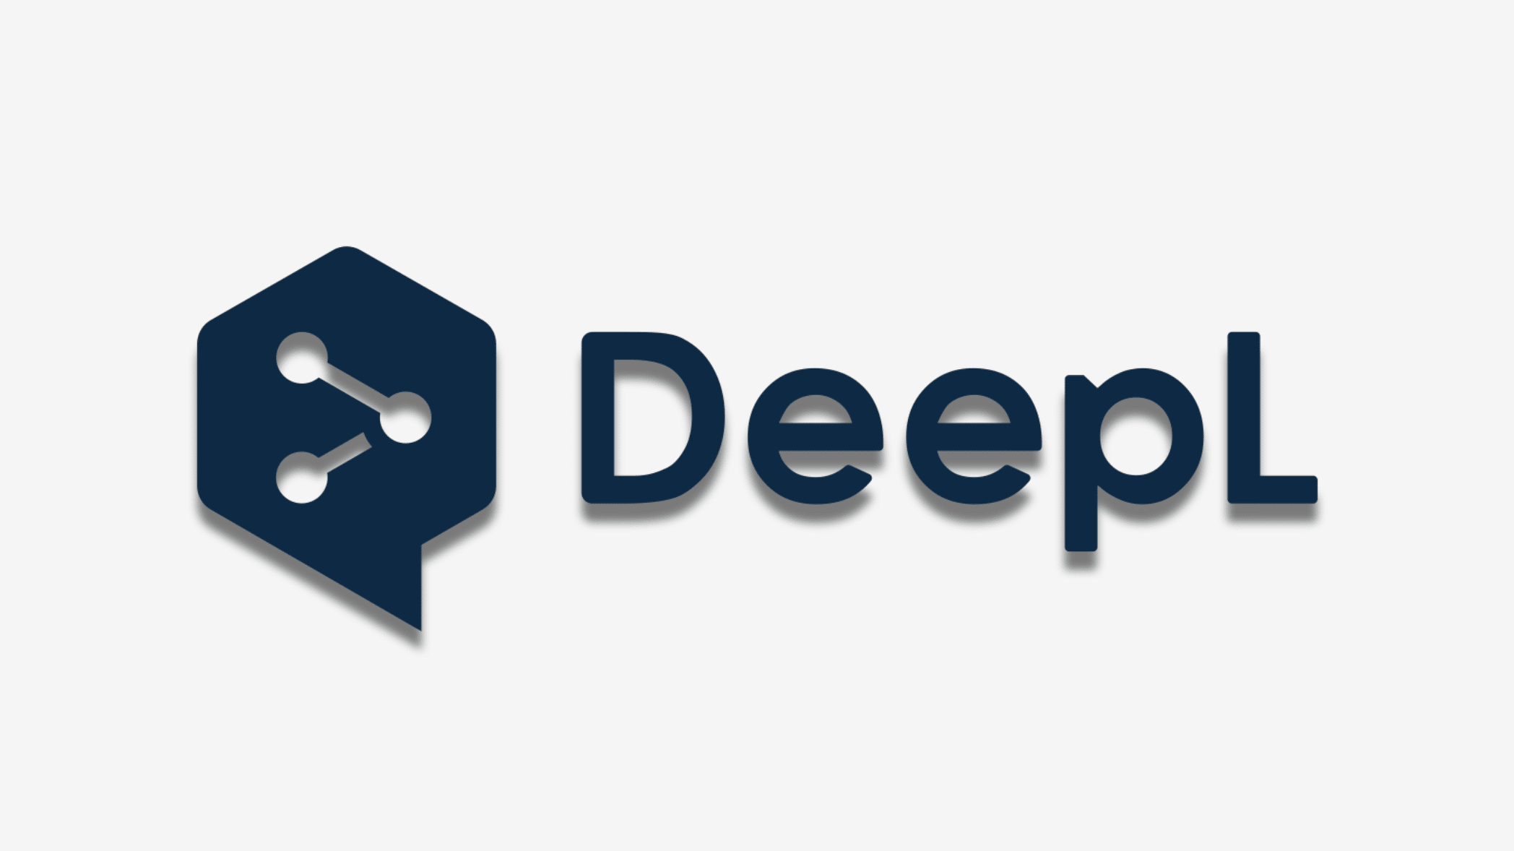






Most Famous Applications
chatbots
autonomous driving
recommendations
translation
MOTOR Ai
robotics
OCR
assistants (speech recognition)
and many more …

Slide 3


When to Use ML (= Learning from Data)
automation
too complex for rules
complexity / uncertainty
too complex for humans
examples: object recognition, all applications from previous slide
from wikipedia
examples: protein structure predictions (AlphaFold), demand forecasting
more scientific use cases: medicine (imaging, diagnosis, drug design), particle physics (analysis of collider experiments), material science (material properties and design of new materials), …

Slide 4
Taxonomy of ML Models

Slide 5

Supervised Learning
Target Quantity
Features
known in training: labeled samples or observations from past
to be predicted for unknown cases (e.g., future values)
input information that is
correlated to target quantity
known at prediction time
Example: Spam Filtering
Classify emails as spam or no spam
use information like occurrence of specific words or email length as features
features x1 and x2 spam, no spam
use accordingly labeled emails as training set
usually rather narrow tasks

Slide 6

Algorithmic Families
linear (parametric) models
nearest neighbors (local methods, instance-based learning) – non-parametric models
decision trees: rule learning
neural networks: non-linear just by means of activation functions
Day
Weekday
Weekend
3
Promo
No
Yes
demand prediction
5
8
often used in ensemble methods
bagging: random forests
boosting: gradient boosting
from wikipedia
kernel/support-vector machines: linear model (maximum-margin hyperplane) with kernel trick
deep learning: many hidden layers
computer vision: CNN
NLP: transformer
mainly used for structured data

Slide 7




MACHINE LEARNING
no supervision, but goal-based interaction with environment
training target available (labeled or past data)
data not labeled in any way
REINFORCEMENT LEARNING
SUPERVISED
UNSUPERVISED
CLASSIFICATION
ASSOCIATION
CLUSTERING
LEARN STATE OR ACTION VALUES
LEARN POLICY DIRECTLY
REGRESSION
DIMENSIONALITY REDUCTION
learning by teacher
(high-dimensional curve fitting)
learning by observation
(pattern recognition)
learning by trial-and-error
(sequential decision making)
unsupervised and reinforcement learning can both be cast as supervised-learning setup

Slide 8

Ladder of Generalization
e.g., ChatGPT (RLHF)
source

Slide 9

Discriminative vs Generative Models
discriminative models:
prediction/estimation of labels (classification) or numerical values (regression)
examples for discriminative tasks:
object recognition
demand forecasting
generative models:
generation of new data according to data distribution seen in training
discriminative model
generative model
source

Slide 10

Text Generation

Slide 11
Large Language Models (LLM)
special class of generative models
new paradigm for ML workflow:
prompt engineering (low/no code)
instead of classic training (fit) and inference (predict) steps
→ multi-task (and multi-modal) models
instead of narrow use cases of discriminative models

Slide 12
Under the Hood: Foundation Models
LLMs: transformer models with hundreds of billions of parameters
self-supervised (pre-)training on vast data sets
→ huge foundation models (impossible to train yourself)
usage options:
typical: in-context learning via prompt (potentially giving few examples for task at hand and add retrieval augmentation or tool usage)
for special case and high-quality requirements: fine-tuning on specific tasks and data sets (example: chatbot like ChatGPT via reinforcement learning from human feedback)

Slide 13

Google’s Gemini:

Slide 14
Goal: Autonomous End-to-End Workflow
not really there yet
LLM/VLM agent
RAG
tool usage
control
domain knowledge
prediction, optimization
decision making
input
input
perception

Slide 15
Generative AI
Depending on the application, there are currently two dominant approaches for generative AI:
text generation: LLMs
image synthesis: diffusion models

Slide 16

Image Synthesis
example: DALL-E 2
idea: generate new images as variations of training data
condition generation on text prompts: text-to-image
trade-off between diversity and fidelity
SOTA: (guided) diffusion models

Slide 17
Application
LLMs are “just” interfaces/translators: transforming one sequence (tokenizable input) into another
discriminative models
generative models
effective for performing numerical and optimization tasks (predictions)
continue to account for majority of AI value in wide range of industries (e.g., supply chain)
not suitable for classical use cases like numerical and optimization tasks
(But LLM agents might use prediction or optimization models as tools.)
but complimentary: drive value across entire organizations by revolutionizing internal knowledge management systems
(natural user interface)

Slide 18
Application Areas

Slide 19
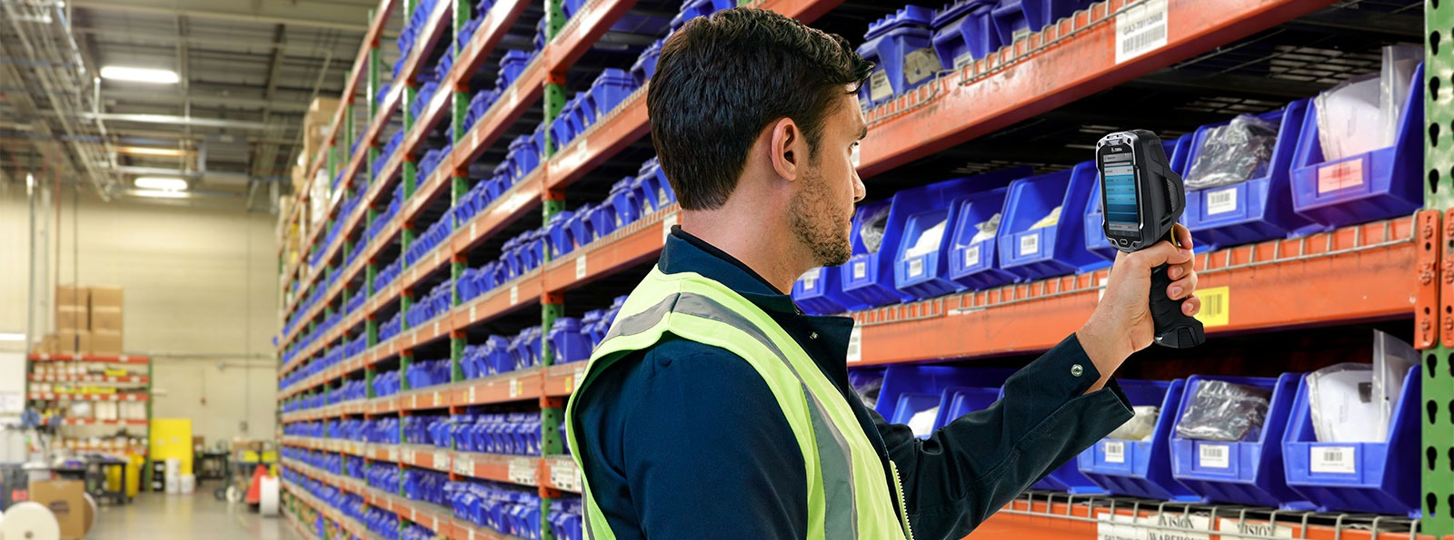
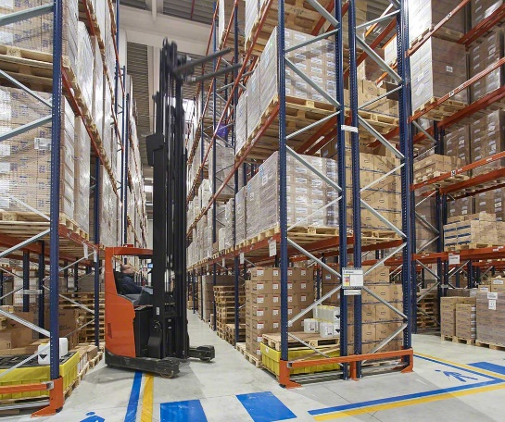
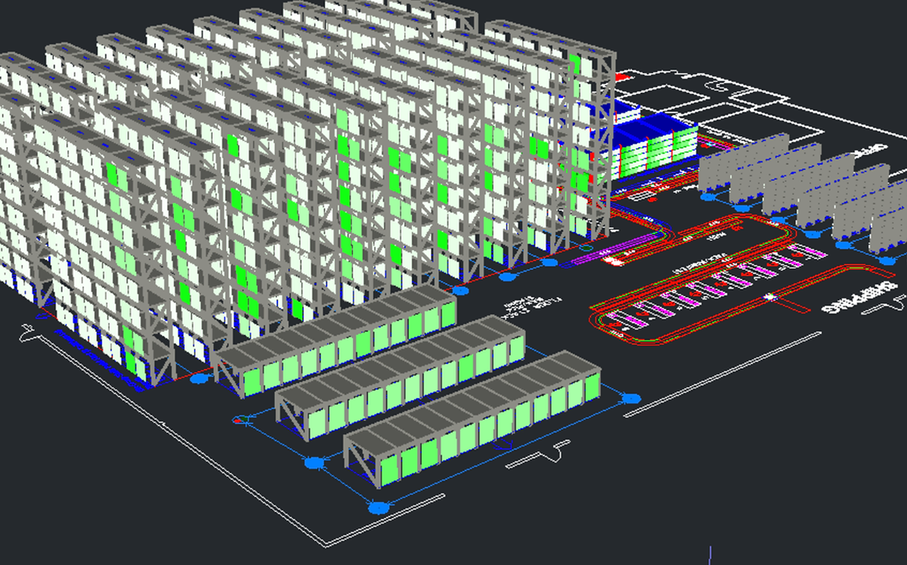
Examples for Predictive Models: Supply Chain
support of operations research
some examples:
warehouse operations
transportation (logistics & mobility)
retail
(Blue Yonder: demand forecasting, replenishment, pricing, targeting)
slotting:
e.g., using item affinity and order forecasting
Supplier
Manufacturer
Distributor
Retailer
Customer
BULLWHIP EFFECT

Slide 20
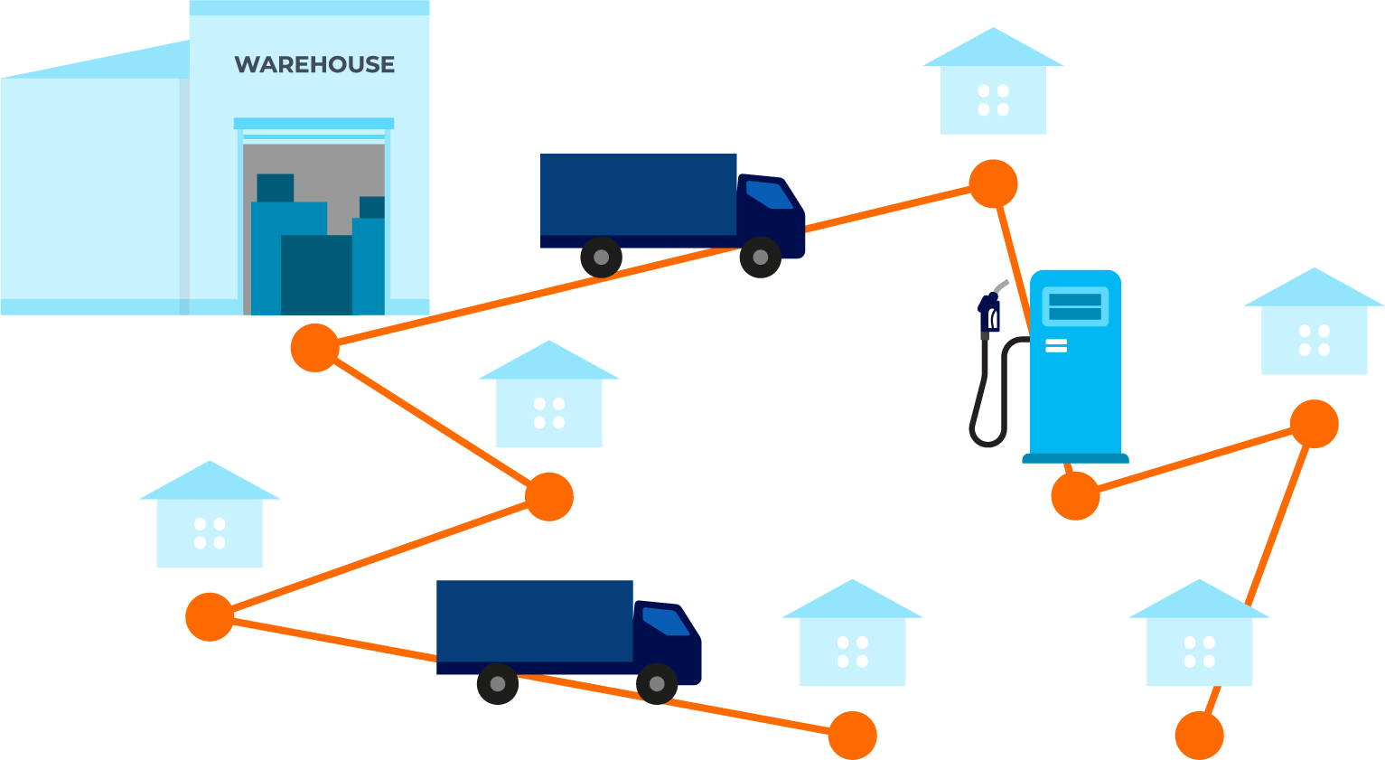
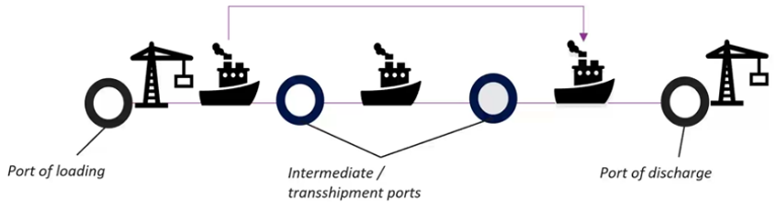
Connected Logistics
examples for ML solutions:
arrival time predictions (aka ETA), for example in Google Maps via Graph Neural Network (GNN)
reinforcement learning (combined with other methods like GNN) for better generalization in combinatorial optimization problems (e.g., TSP, VRP, …)
disruption predictions (also root cause analysis)

Slide 21
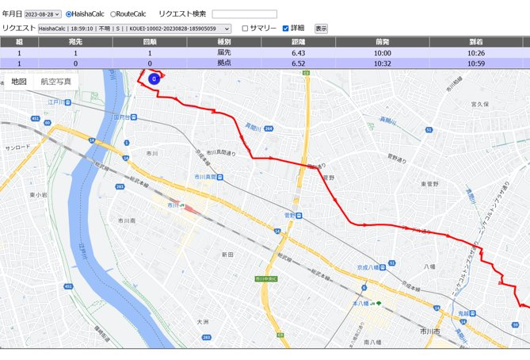
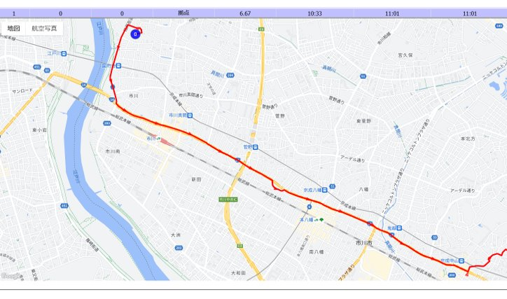
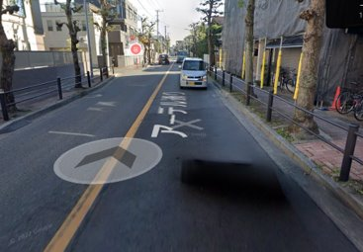
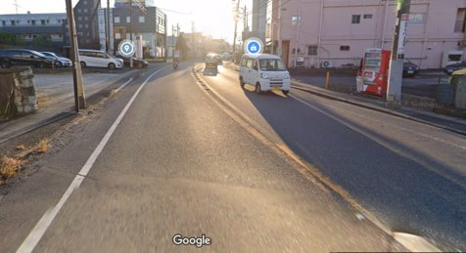
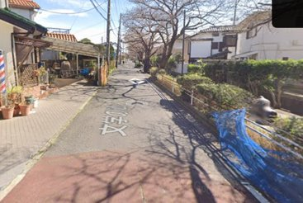
Routing: Learning from Skilled Drivers
shortest route:
better route:
supervised learning

Slide 22

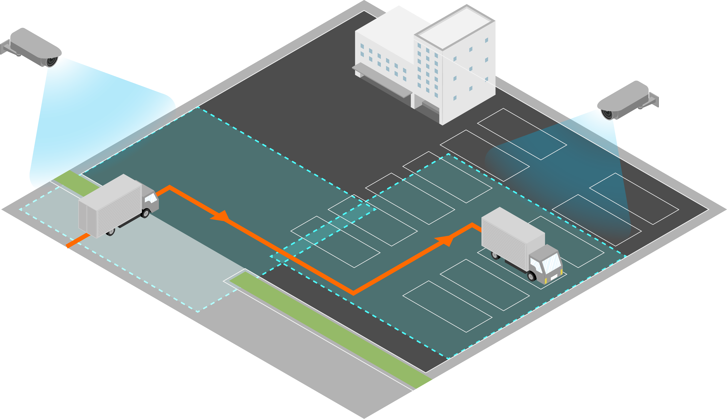
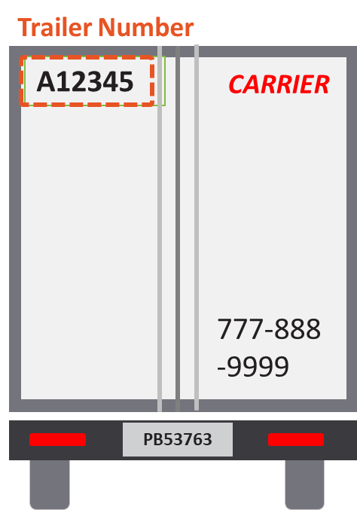
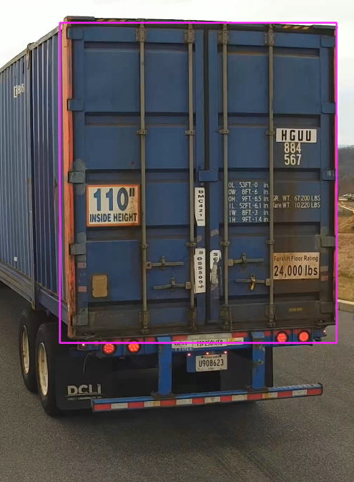
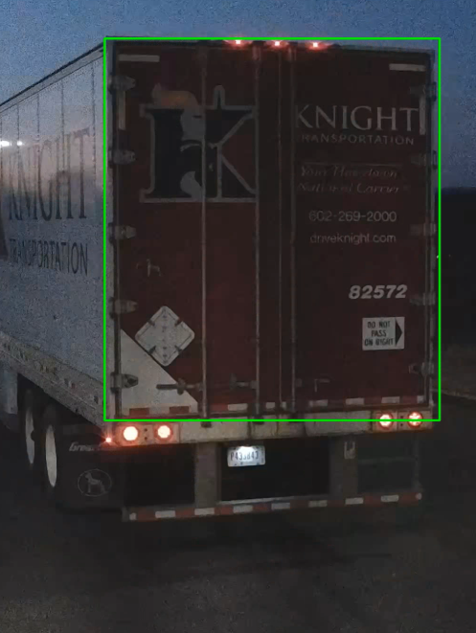
Tracking for Yard Management
trailer ID recognition at gate
computer vision
tracking across cameras

Slide 23
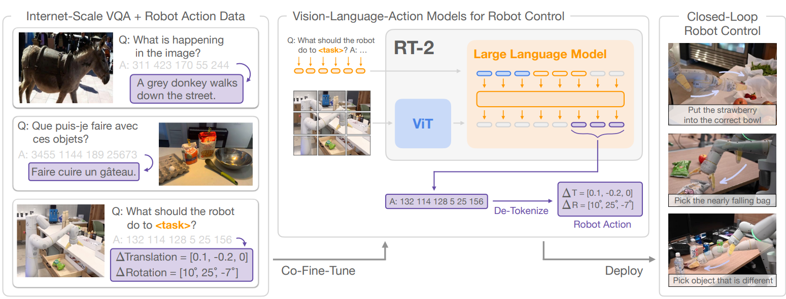
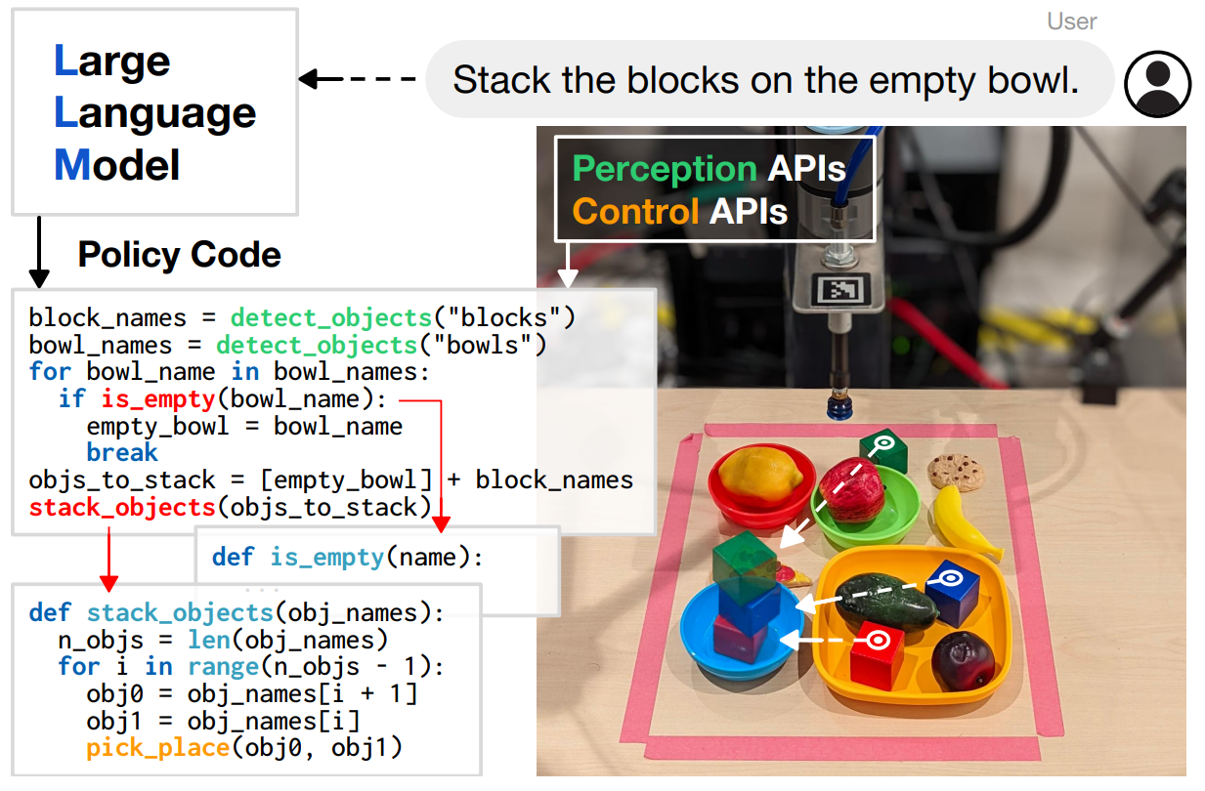
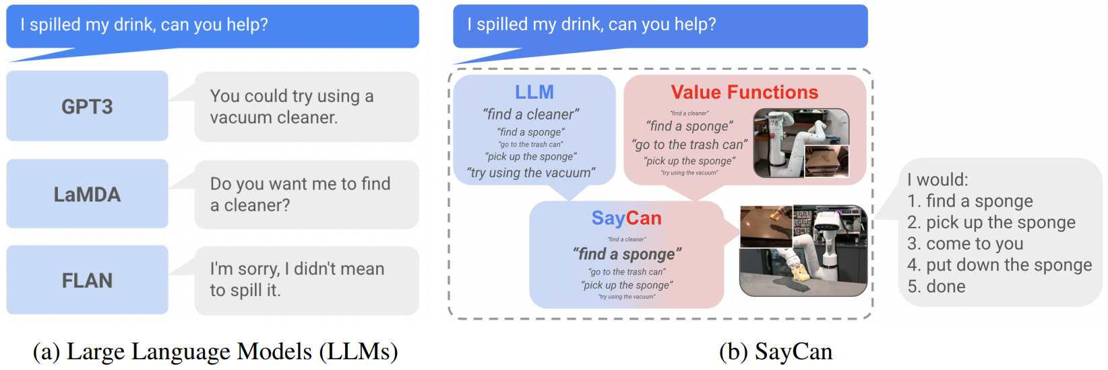
Robotic Control
generalization with pre-trained vision-language models (RT-2):
different ways:
reactive control (no ML)
model predictive control
imitation learning
reinforcement learning
using LLMs (and vision)
Code as Policies:
grounding with pre-trained skills (SayCan):

Slide 24
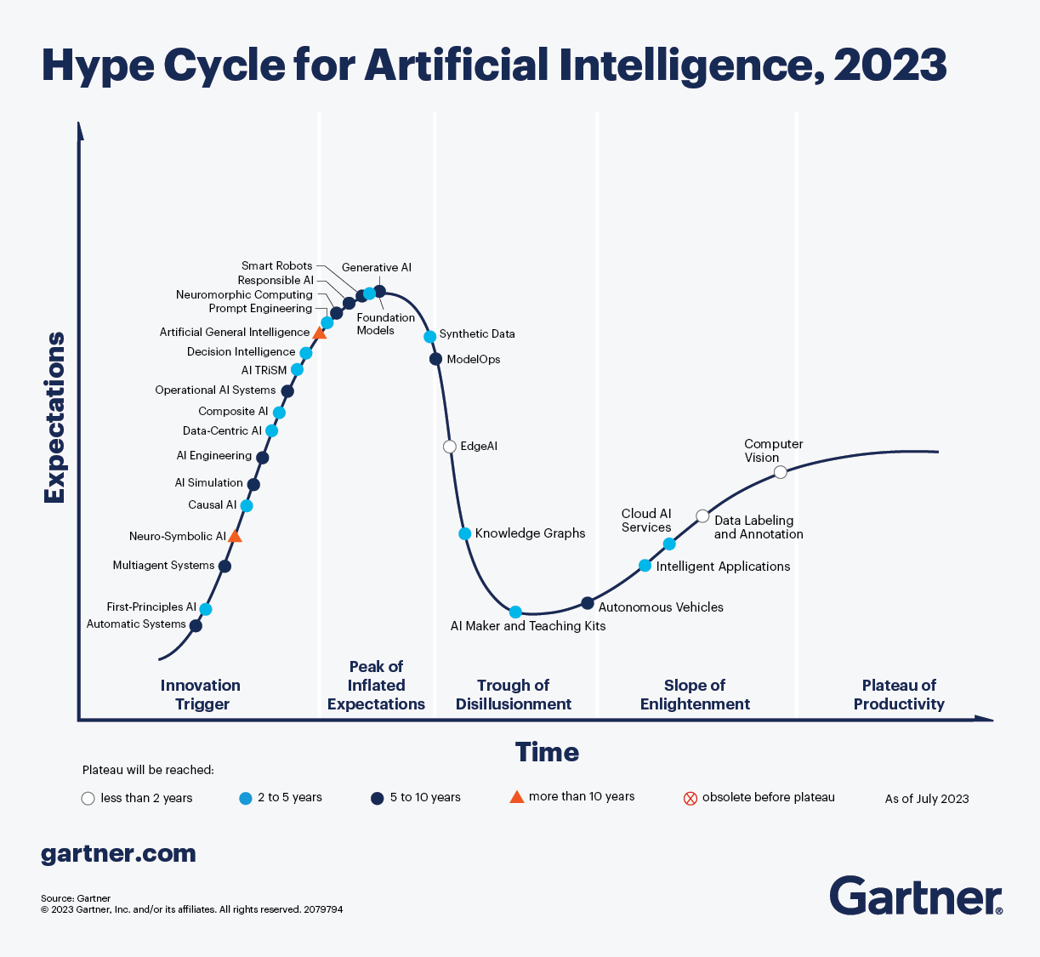
Generative AI at peak of inflated expectations
still: there is now something to play with

Slide 25
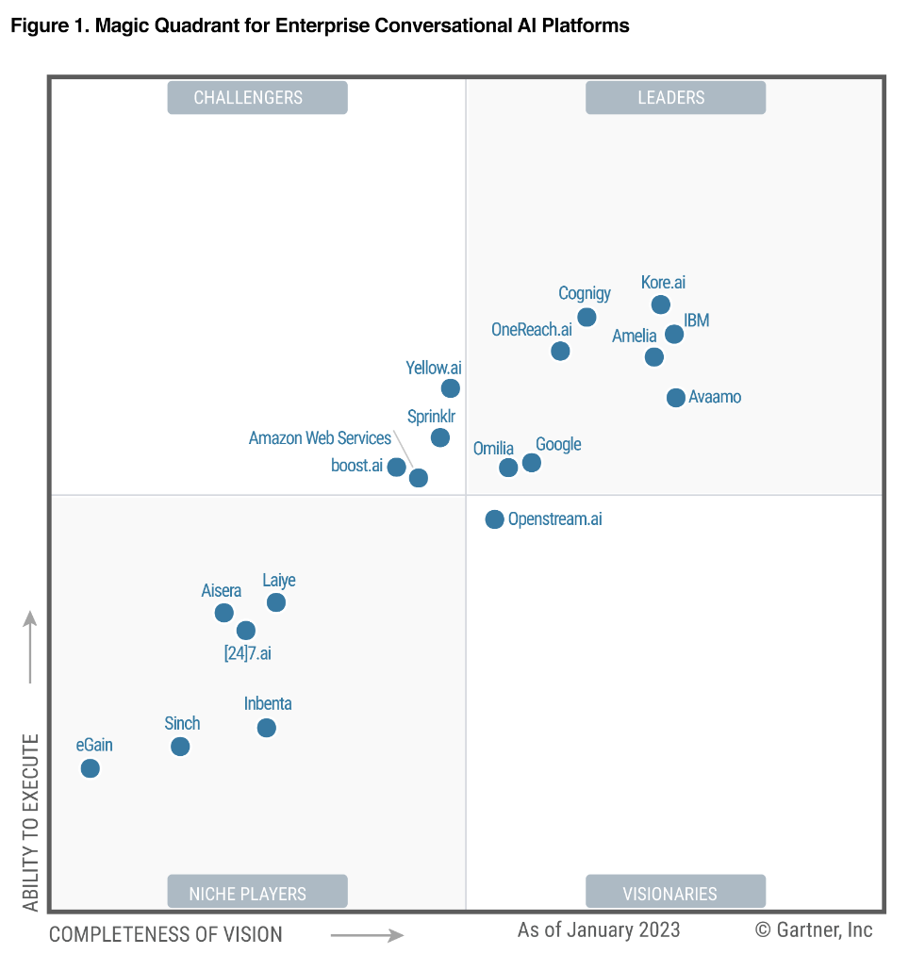
Biggest Business Impacts of Generative AI
customer operations
interactions with customers
marketing & sales
generation of creative content
software engineering
coding assistant
product R&D
generative design (e.g., for chips)

Slide 26
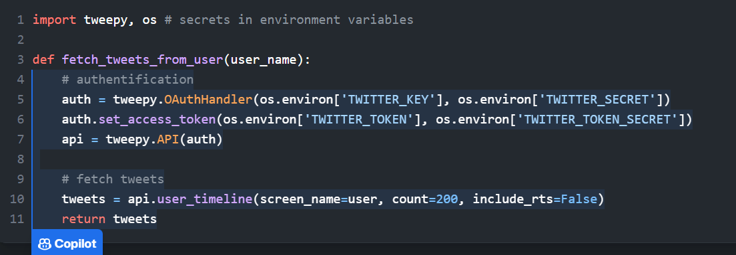
Coding Assistant
LLM: text-to-code
prominent example: GitHub Copilot

Slide 27


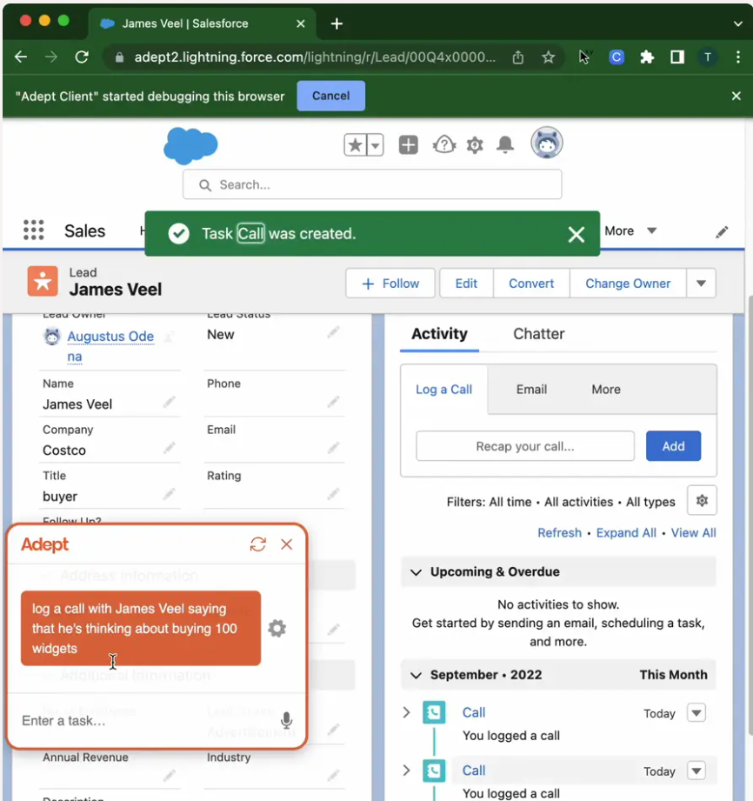
Copilot for Knowledge Workers
multi-modal models (text and images) enable image understanding
and execution of high-level user requests
source
source

Slide 28
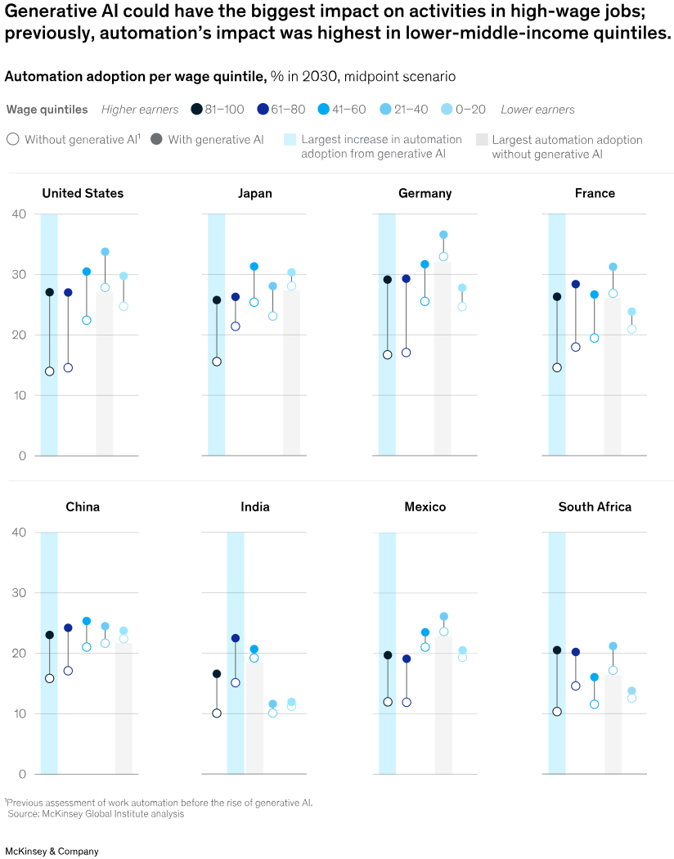
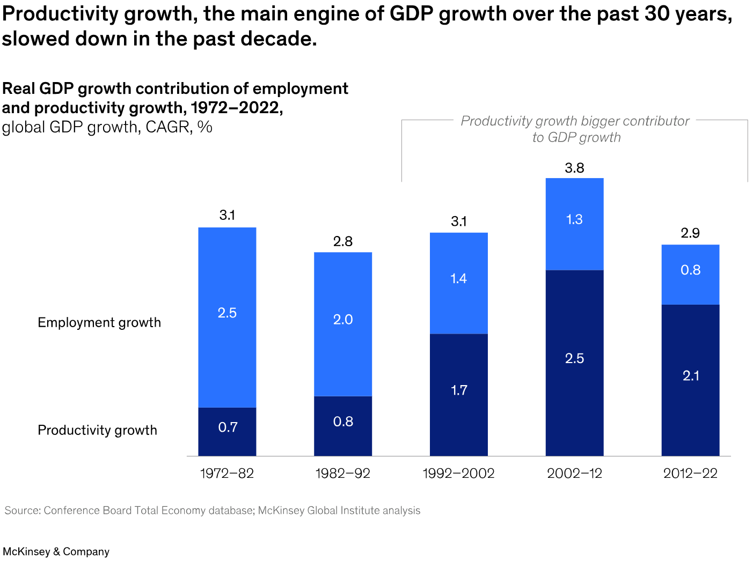
AI Potential
automate white-collar more than blue-collar jobs
(generative) AI could free up 70% of employees’ time
half of today’s work activities could be automated between 2030 and 2060

Slide 29
Engineering & Tech Stack

Slide 30

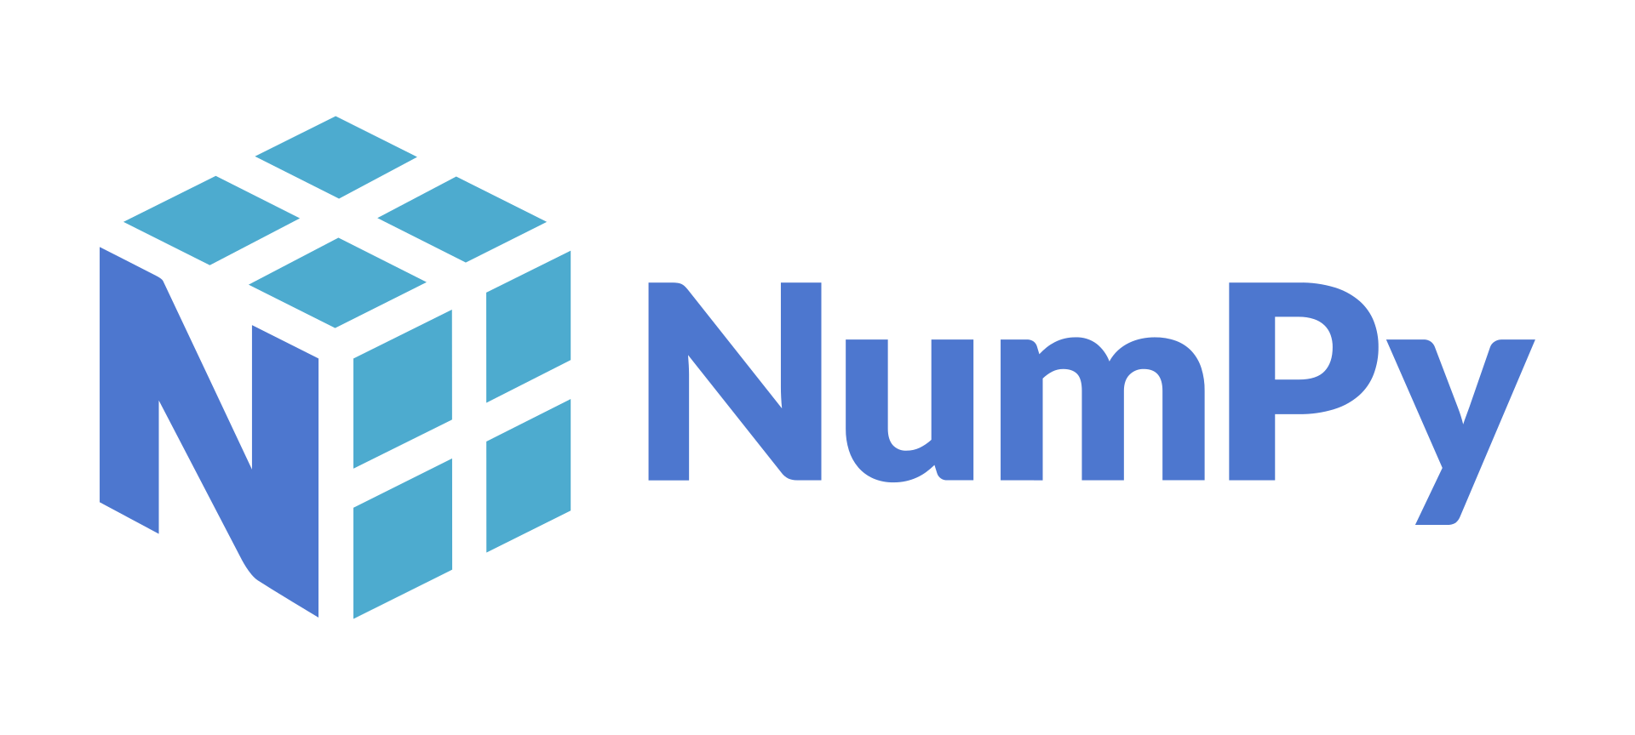




Scientific Python Stack

Slide 31


Deep Learning Frameworks
need for lots of memory and compute …

Slide 32






IaaS, PaaS, SaaS
example for managed service: Azure Kubernetes Service (AKS) for container orchestration

Slide 33
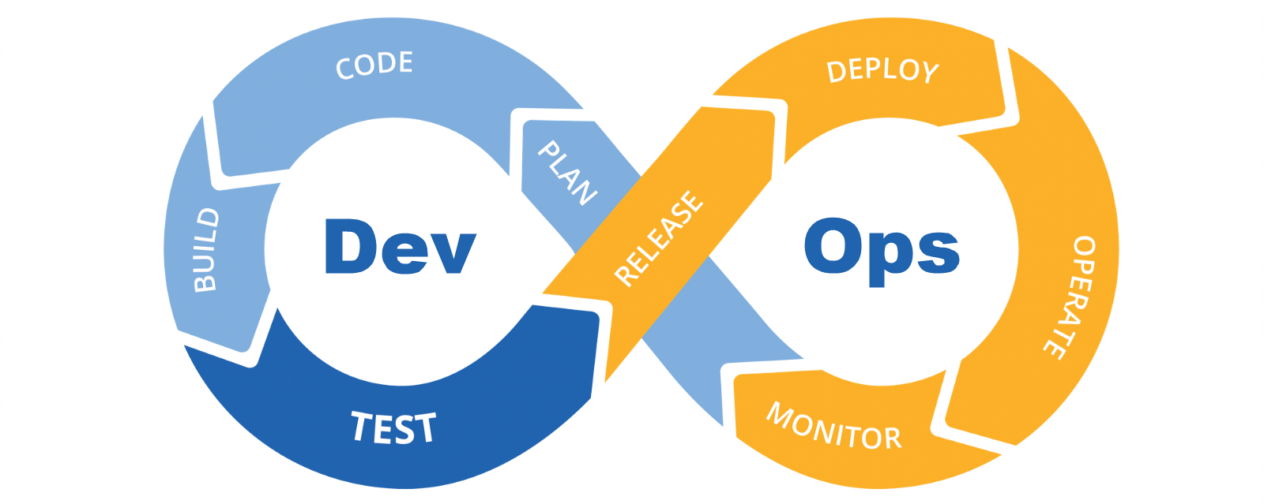
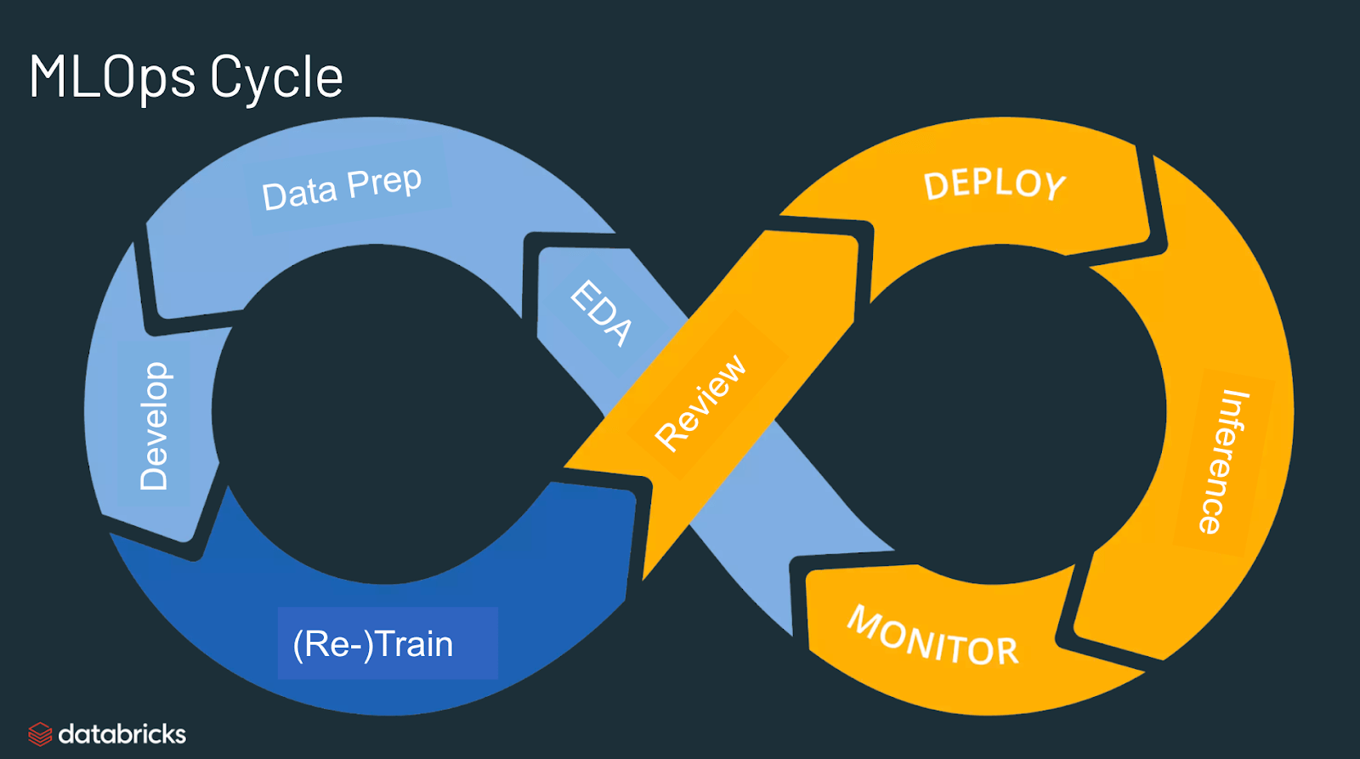
ML in Production
examples for managed ML services: Azure ML, SageMaker

Slide 34




Data Management
not only compute but also cloud-based data storage
data lake: raw data
data warehouse: integrated data
unification of data lake and warehouse: ETL → ELT
NoSQL example: graph database

Slide 35
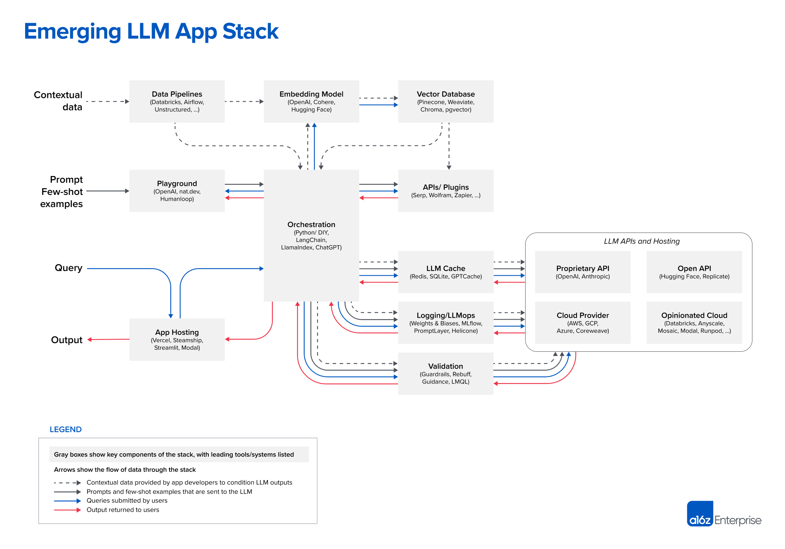
era of large-scale models:
AI currently on its engineering peak
(pre-)training out of reach for most
but applicable thanks to multi-task capabilities of in-context learning

Slide 36
What the Future Holds: Autonomous Agents
learning from data
cyber
model:
cognition
and other inputs
and other decisions
multimodal
multitask
robotics:
action
agency
sensing:
perception
physical

Slide 37
Facts and Fiction
no more AI winters
data is everywhere, plenty of useful ML products
“classical” ML still needed
most value from predictive applications
Generative AI important step
“mirror” to see the world in different light
(probably) still Chinese room
no reliable indication for real understanding
AGI is not here (yet)
but performance of multi-task and multi-modal models still improving with scale
AI no (foreseeable) existential risk
more realistic and near-term risk: small number of companies control AI technology

